Slide 1
Metabolic changes associated with a
mouse model of obesity and metabolic disease
University of Tennessee Health Science Center Ramesh Narayanan, PhD
UTEN-01-15VW July 31, 2015

Slide 2
Study Overview
Study Objective
The goal of this study was to interrogate biochemical profiles manifested in mouse serum, liver tissue and white adipose tissue with the aim of characterizing metabolic migration associated with diet and an undefined drug treatment.
Study Design
Global biochemical profiles were determined in mouse serum, liver tissue and white adipose tissue collected from the treatment groups shown below. Treatment duration was nine weeks; animal age was not provided and treatment compound identity was not disclosed.
Group | n |  |  | Description
 | Serum | Liver | WAT
Bsl | 4 | --- | --- | Baseline sample
ND Veh | 4 | 4 | 4 | Normal diet, vehicle treated
HFD Veh | 4 | 4 | 4 | High fat diet, vehicle treated
HFD Tx | 4 | 4 | 4 | High fat diet, drug treated

Slide 3
Statistical Summary
Statistical Comparisons Welch's Two-Sample t-Test
Significantly Altered Biochemicals |  | Total biochemicals p≤0.05 | Biochemicals (↑↓) | Total biochemicals 0.05<p<0.10 | Biochemicals (↑↓)
Serum | ND Veh Bsl | 228 | 196|32 | 67 | 61|6
 | HFD Veh Bsl | 306 | 248|58 | 48 | 38|10
 | HFD Tx Bsl | 302 | 222|80 | 51 | 39|12
 | HFD Veh ND Veh | 224 | 139|85 | 52 | 38|14
 | HFD Tx HFD Veh | 116 | 18|98 | 49 | 14|35
 | HFD Tx ND Veh | 238 | 126|112 | 55 | 26|29
Liver Tissue | HFD Veh ND Veh | 191 | 90|101 | 44 | 28|16
 | HFD Tx HFD Veh | 115 | 34|81 | 57 | 23|34
 | HFD Tx ND Veh | 201 | 77|124 | 50 | 27|23
White Adipose Tissue | HFD Veh ND Veh | 317 | 11|306 | 58 | 3|55
 | HFD Tx HFD Veh | 198 | 195|3 | 105 | 101|4
 | HFD Tx ND Veh | 47 | 5|42 | 34 | 1|33
From a total of 569 named biochemicals in serum,
560 in liver, and 481 in white adipose tissue.

Slide 4
Data Display
Metabolite Name
Box Plot Legend
Scaled Intensity
Treatment Group

Slide 5
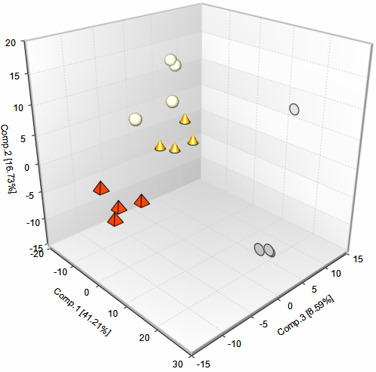
Principal Component Analysis/ Hierarchical Clustering (Serum)
Complete Euclidean Cluster
Superpathway:
Group:

Slide 6
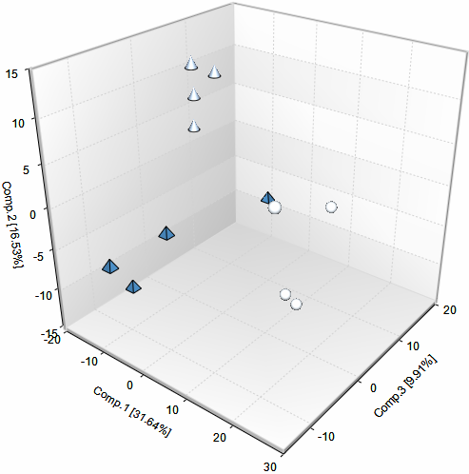
Principal Component Analysis/ Hierarchical Clustering (Liver)
Complete Euclidean Cluster
Superpathway:
Group:

Slide 7
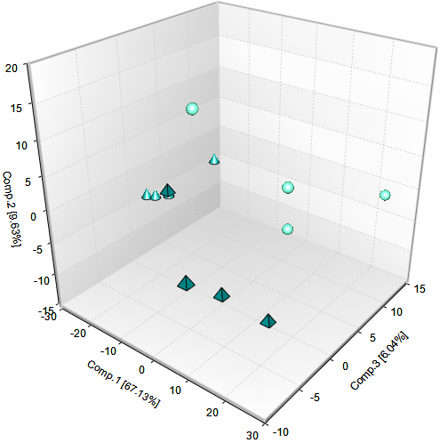
Principal Component Analysis/ Hierarchical Clustering (White Adipose Tissue)
Complete Euclidean Cluster
Superpathway:
Group:

Slide 8
Random Forest- HFD Veh vs. ND Veh (Serum)
Random Forest classification using named metabolites in the Serum of the HFD Veh and ND Veh groups resulted in a predictive accuracy of 100%.
Increasing Importance to Group Separation
mean-decrease-accuracy

Slide 9
Random Forest- HFD Veh vs. ND Veh (Liver)
Random Forest classification using named metabolites in the Liver of the HFD Veh and ND Veh groups resulted in a predictive accuracy of 100%.
Increasing Importance to Group Separation
mean-decrease-accuracy

Slide 10
Random Forest- HFD Veh vs. ND Veh (White Adipose Tissue)
Random Forest classification using named metabolites in the White Adipose Tissue of the HFD Veh and ND Veh groups resulted in a predictive accuracy of 100%.
Increasing Importance to Group Separation
mean-decrease-accuracy

Slide 11
Random Forest- HFD Tx vs. HFD Veh (Serum)
Random Forest classification using named metabolites in the Serum of the HFD Tx and HFD Veh groups resulted in a predictive accuracy of 100%.
Increasing Importance to Group Separation
mean-decrease-accuracy

Slide 12
Random Forest- HFD Tx vs. HFD Veh (Liver)
Random Forest classification using named metabolites in the Liver of the HFD Tx and HFD Veh groups resulted in a predictive accuracy of 88%.
Increasing Importance to Group Separation
mean-decrease-accuracy

Slide 13
Random Forest- HFD Tx vs. HFD Veh (White Adipose Tissue)
Random Forest classification using named metabolites in the White Adipose Tissue of the HFD Tx and HFD Veh groups resulted in a predictive accuracy of 88%.
Increasing Importance to Group Separation
mean-decrease-accuracy

Slide 14
Metabolite Levels Were Significant Lower in the Adipose Tissues of the HFD Veh Group
215_WAT
Note: Metabolite levels were significantly lower in one of the HFD TX samples as well. This sample has been indicated with an arrow in the heatmap above and corresponds to the sample with the client ID 215_WAT. The effect of the treatment on adipose metabolism may have differed therefore in this particular mouse.

Slide 15
Notable Increases in the HFD VEH vs. ND VEH Comparison (Adipose Tissue)
Nucleotide monophosphates
Fat Soluble Vitamins
(vitamin E)
(vitamin E)

Slide 16
Dietary and Drug-Dependent Changes in Fatty Acid Levels and Metabolism (Serum and Liver)
Free Fatty Acids (Serum)
Acylcarnitines (Serum)

Slide 17
Dietary and Drug-Dependent Changes in Glycerophospholipid Metabolism (Serum and Liver)
Phospholipid metabolism (Liver)
Phospholipid metabolism (Serum)

Slide 18
Dietary and Drug-Dependent Changes in Sphingolipid Metabolism (Serum and Liver)
Serum
Liver

Slide 19
Alterations in Food-Derived Metabolites in the HFD-Fed Mice (Serum)

Slide 20
Alterations in Food-Derived Metabolites in the HFD-Fed Mice (Serum and Liver)
Serum
Plant Derived Sterols (Serum and Liver)

Slide 21




